Slide 1
Experiences integrating CSM with a caCORE-Based DataService
Mark Grand
mgrand@emory.edu
Center for Comprehensive Informatics
Emory University

Slide 2
Overarching Goals
Develop attribute- and instance-level access control support
  mainly motivated by CVRG and RT use cases as well as use cases from ACTSI
Leverage caBIG technologies
Support a range of data service types
  caCORE-based, XML data services, and image data services

Slide 3
CardioVascular Research Grid
Developing an informatics resource for multi-institutional cardiovascular research
Grid architecture built on caGrid and leverages other caBIG technologies
Various types of data services
  caCORE-based, XML, and DICOM data services
  OpenClinica, SNP, ECG, Analysis results, and Imaging

Slide 4
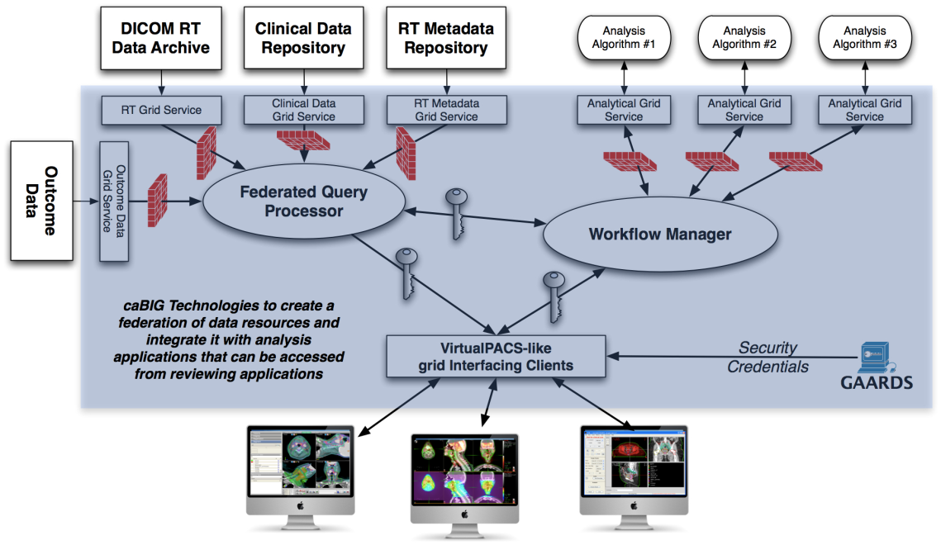
Radiation Therapy Enterprise Use Case
Develop a testbed for real-world evaluation and subsequent usage of caGrid-based tools for supporting RT based clinical trials
Architecture built on caGrid, IVI middleware and other commercial and open source technologies from the RT domain
Various data sources (PACS, XML), analytical routines (Image registration, voxel tracking, DVH) and review clients (CERR, Velocity)
Schematic of a caGrid enabled system to support RT based Clinical trials

Slide 5
OpenClinica Data Service
OpenClinica data service is the first test case.
An open-source clinical data management system
  Facilitates management of subject, study, and CRF data
A caGrid data service developed to query study, subject, and CRF information.
Uses PostgreSQL backend

Slide 6
OpenClinica Grid Data Access Requirements
Need to limit access to only what a user is authorized to see.
Control access to a portion of the information model
  A user can access CRF data but not subject and study objects
Control access to a subset of database
  A user can see a subset of studies and a sub-group of subjects based on attribute values

Slide 7
CSM Integration Goals
Use CSM to authorize users to access data over the Grid
Integrate CSM instance-level security with OpenClinica Data Service to support use cases
CSM is the recommended instance-level authorization tool for caGrid.
CSM instance-level security is new, so we need to explore its quality and limits.

Slide 8
Challenges
Only available documentation is beta and not specifically for this scenario.
https://cabig-kc.nci.nih.gov/CaGrid/KC/index.php/Create_a_Secure_Data_Service_using_CSM_for_Data-Level_Authorization
  Makes assumptions you are integrating with results of a preceding bootcamp exercise.
  Steps related to configuring CSM authorization policy are difficult to translate to other services and policies without knowing more about CSM.
Latest version of CSM untested with PostgreSQL
CSM API interpretation of instance-level security model is unsuitable for many scenarios
No convenient way to use GridGrouper groups.
  GridGrouper is the caGrid mechanism for managing groups of users for authorization purposes.

Slide 9
Improvising Build Steps
Used notes from a boot camp exercise
Collaborated with documentation author to improve documentation.
Exercise assumed some results from previous exercises and had other mismatches
Some needed manual edits to files had to be discovered by debugging, i.e., massaging hibernate mappings
caGrid KC supplied patches to fix version mismatches.
The caGrid KC was very helpful.

Slide 10
Version & Database Mismatches
UPT (CSM admin tool) 4.2 is required administer instance-level authorization.
CSM/caGRID integration support was for CSM 4.1.0.2 (now 4.1.0.3).
UPT 4.2 installer for PostgreSQL had not been released; the PostgreSQL version was untested.

Slide 11
CSM API Unsuitable for Security Scenarios
CSM API filters instance results but allows probing
CSM API implements instance-level security with hibernate filters
Hibernate filters are not well suited for this use

Slide 12
Sample Vulnerability Scenario
User X can access Study A subjects; Y can access Study B subjects
X shouldn’t know which subjects are also in B; Y shouldn’t know which subjects are also in A
CSM_API does not prevent this
Subject 1
Study A
Subject 2
Study B
Subject 3

Slide 13
Attribute Level Security
CSM API supports attribute level security
Similar problem to instance-level security:
Only results are filters
Unauthorized attributes can be probed
This problem can be solved by a replacement CQL processor that rejects queries that reference unauthorized attributes.

Slide 14
CQL_CSM
Removed vulnerability by creating a replacement CQL processor called CQL_CSM.
Generates SQL “where” constraints
Current version driven by caCORE-generated hibernate mapping and CSM API initialization.
Dependency on caCORE and CSM API could be replaced with new version driven by data service's domain model.

Slide 15
CSM Grid Service
Steve Langella and Scott Oster wrote a service to synchronize CSM groups with gridGrouper groups.
UI integrated with GAARDS.
UI also administers all CSM data.
No installation or version mismatch problems.

Slide 16
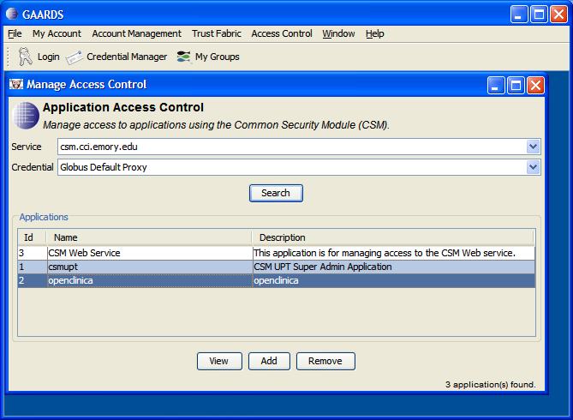
Application Access Control

Slide 17
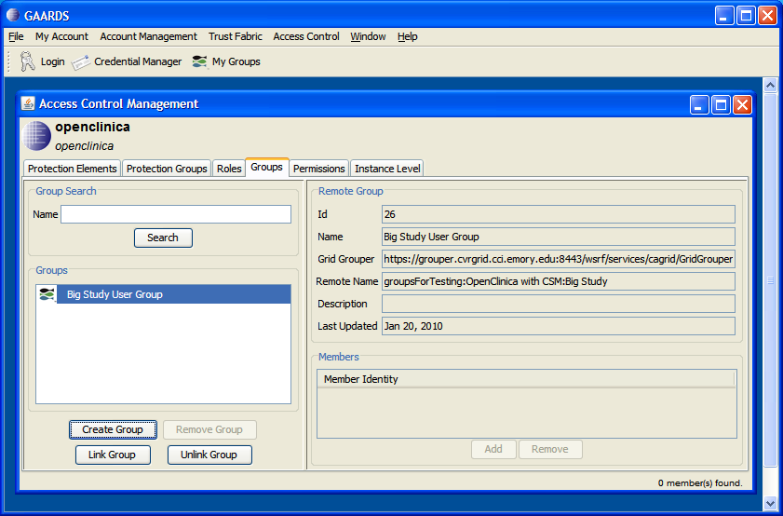
Access Control Management

Slide 18
Additional CSM Integration Planned
DICOM Data Service and rest of IVI middleware services
Limitations of DICOM protocol necessitate filtering results or preprocessing data.
A version of CQL_CSM that does CQL re-writing is planned.
  It will be used with the XML data service infrastructure.

Slide 19
Conclusions
Integrating the CSM API with a caCORE based caGRID data service is a tricky process involving many steps.
The instance-level authorization provided by the CSM API does not meet the needs of many caGrid applications. CSM_CQL is a better fit.
Making CSM_CQL independent of CSM and caCORE will make integration much easier.
Using Steve Langella’s tool is a convenient and effective way to sync CSM groups with caGrid groups.

